Slide 1
Chapter 6 (continued): Biotech Techniques
The applications/uses of biotechnology tools

Slide 2

Biotechnology – vocabulary
Amplifying
Annealing
DNA ladder
Genome
Plasmid
Micropipette
Short Tandem Repeat (STR)
Vector
Table 6.4 on p175-177 Card sort activity

Slide 3

Biotechnology tools
PCR
Gel electrophoresis
DNA sequencing
Recombinant DNA
Microarrays

Slide 4

PCR – Amplifying DNA
Polymerase Chain Reaction
Technique used to rapidly replicate small amounts of DNA
E.g. From a crime scene, from bones
Amplified DNA used later in other techniques such as gel electrophoresis or DNA profiling

Slide 5
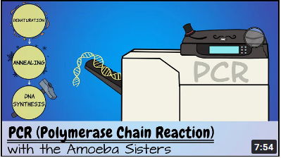
Amoeba Sisters Video

Slide 6
PCR – Amplifying DNA
Ingredients:
Original DNA
Taq polymerase
Buffer solution
Free nucleotides
DNA primers

Slide 7
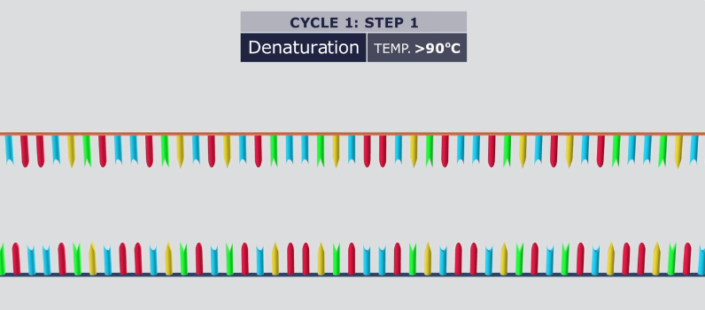
Step 1 – Denaturing DNA
Heat sample DNA to 95ºC
Breaks H-bonds between bases
Separates strands

Slide 8
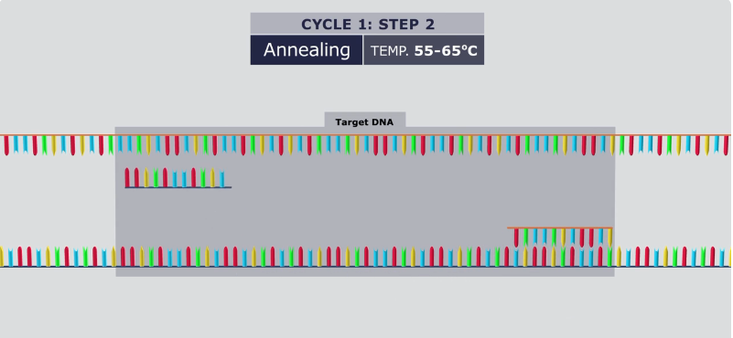
Step 2 – Annealing
Temperature lowered to 55-65ºC
Primers bind to ends of target DNA sequence

Slide 9
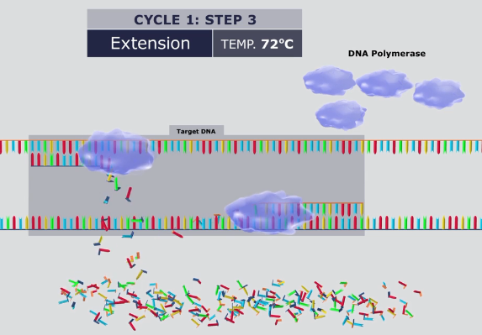
Step 3 – Extension
Temperature 72ºC, optimal for Taq polymerase enzyme
Attaches to primers, moves along strand, attaching free nucleotides
Ends with twice amount of DNA

Slide 10

Activities
Nelson textbook QS 6.3a, p180

Slide 11
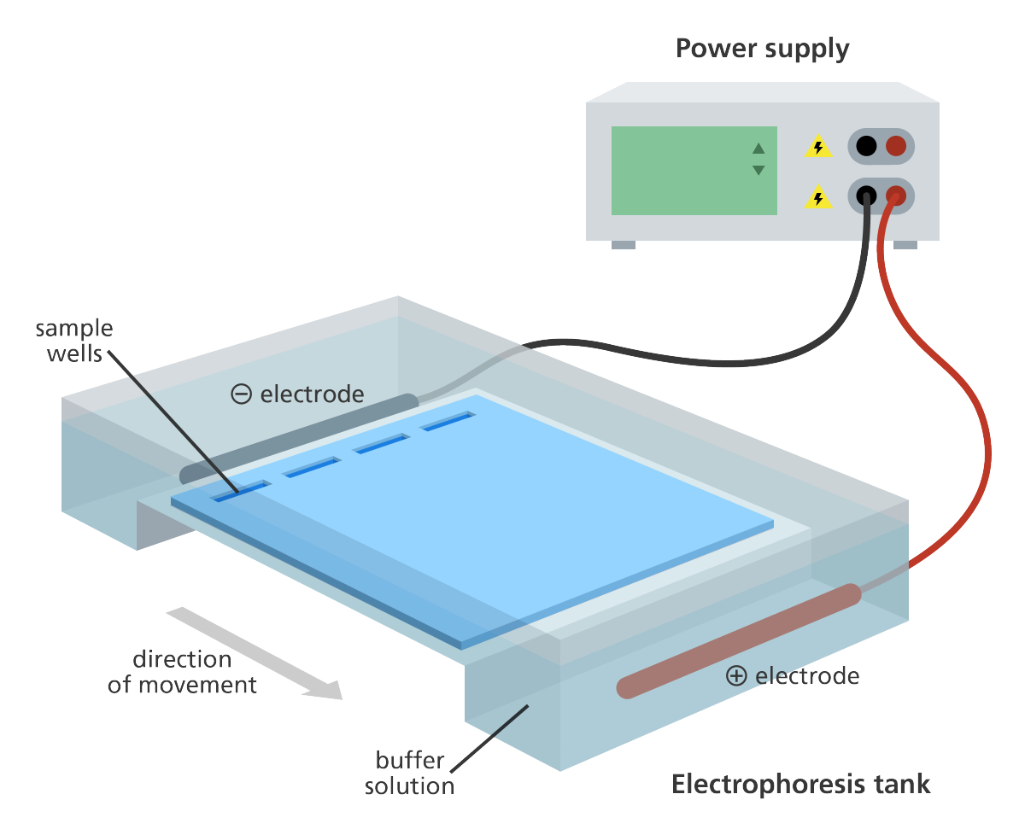

Slide 12
Gel electrophoresis
Way of visualising DNA and comparing samples
Samples of DNA are cut into fragments using REs
Loaded into wells on agarose gel
Negatively charged fragments drawn through gel by electric current
Smaller fragments move faster and further

Slide 13
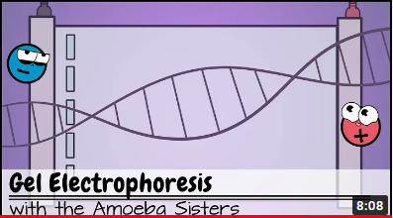
Amoeba Sister Video

Slide 14
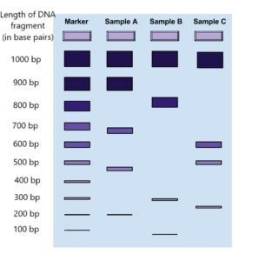

Slide 15
Activities
Nelson textbook QS 6.3b, p183-184
Nelson textbook Activity 6.1, p199-200 and 212, “Brood parasitism and family size in black swans”

Slide 16
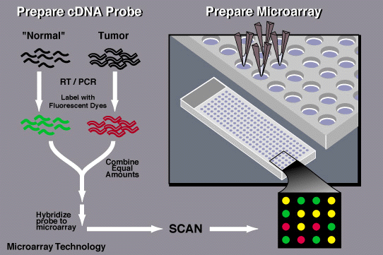
Microarrays – Probing for genes
Tool used to determine if DNA from an individual contains a particular gene expression
Probe is a short sequence of DNA made radioactive
Target sequence is complementary to probe
Probe attaches and fluoresces to show presence of gene
E.g. BRCA1 and BRCA2 genes for breast cancer

Slide 17
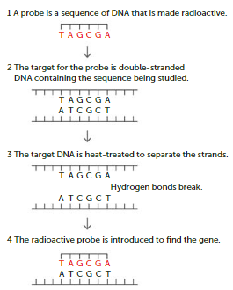

Slide 18
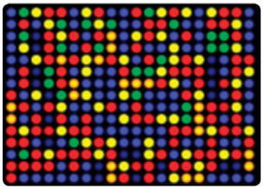
Microarrays – probing for genes
Thousands of DNA probes arrayed on a single glass microscope slide or silicon chip →
Probes allowed to bind to genes
A scanner measures fluorescence
Analyse to find gene activity
Brighter colour, more activity
More info at BioNinja

Slide 19
Activities
Nelson textbook QS 6.3c, p185

Slide 20
DNA sequencing
Refers to the methods and technologies used to determine the exact order of nucleotide bases in DNA fragments
Useful to identify abnormal gene function, future applications in conservation and agriculture
Two methods:
Sanger method
Next-generation sequencing

Slide 21
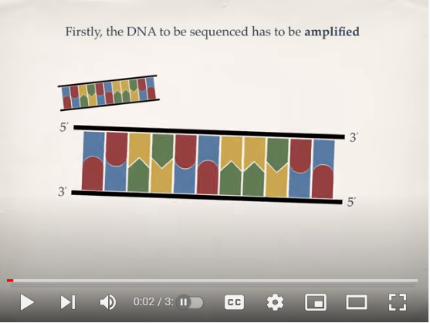
DNA sequencing – Sanger method

Slide 22
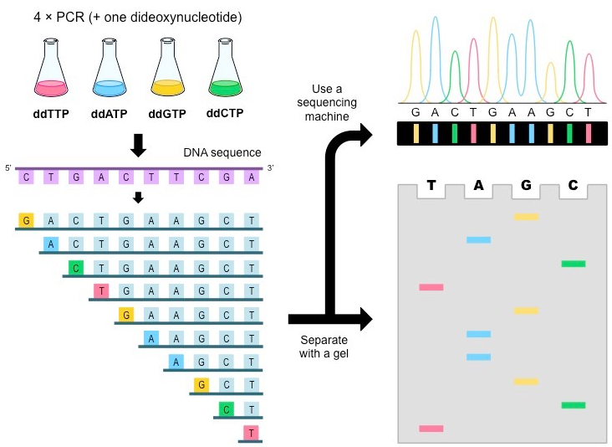

Slide 23
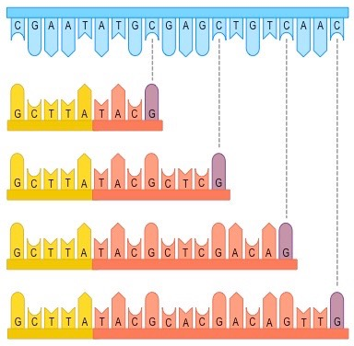
DNA sequencing – Sanger method
Four PCR mixtures are made up, containing normal nucleotides PLUS one dideoxynucleotide (ddA, ddT, ddC, ddG)
ddNTPs are modified nucleotides that integrate into the sequence but prevent the addition of anything after it →
Terminates sequence causing fragments

Slide 24
DNA sequencing – Sanger method
PCR generates billions of copies of DNA, so will make all possible fragment lengths
Fragments are separated using gel electrophoresis
If a dye is added, fragments can be read by a machine

Slide 25
DNA sequencing – NGS
More advanced than Sanger method
DNA prepared: Broken into fragments ~300bp then amplified by PCR
Sequencing: On gel plate, each well contains ddNTPs with fluorescent tags added to fragments
Data analysis: Flashes of light reveal the sequence of nucleotides – a different colour for each base – and software identifies the order

Slide 26
Activities
Application 6.1 “Comparative genomics between humans and fruit flies”, p188
Case Study “Use of next-generation sequencing to study ecosystem biodiversity”, p188-189
QS 6.4a, p190

Slide 27
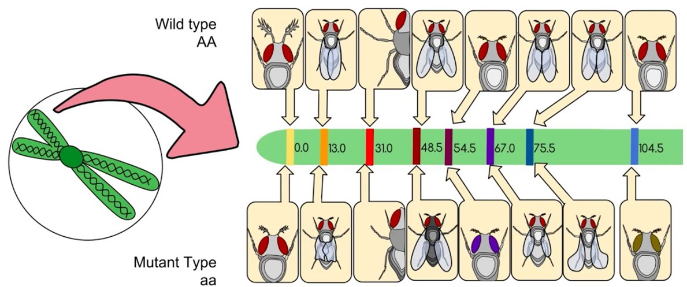
DNA sequencing – Genome mapping
Genome – entire set of genetic instructions (both coding genes and non-coding)
Genetic mapping identifies and records the position of genes on a chromosome (locus)

Slide 28
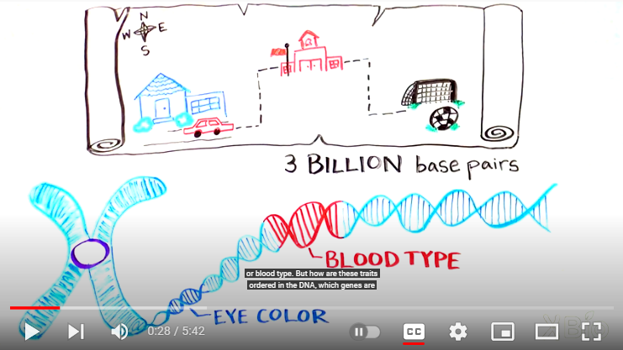
DNA sequencing – Genome mapping video

Slide 29
Activities
QS 6.4b, p191
Scientific Literacy “Using genetic markers in the quest to save our vulnerable burrowing bettong”, p192-193

Slide 30
DNA profiling
Also known as DNA fingerprinting
The process used to compare the base sequence of two or more individuals to determine how closely related they are
Most DNA is identical except for specific regions called polymorphic regions
Unique combination of polymorphic regions inherited from parents

Slide 31
DNA profiling
Short Tandem Repeats (STRs) – regions of non-coding DNA that repeats same sequence
E.g. GATAGATAGATAGATAGATAGATAGATAGATAGATA
Each individual has unique number of repeats for each gene
10+ STR loci compared to produce a DNA profile
Use PCR and gel electrophoresis to make profiles and compare

Slide 32
Activities
QS 6.5, p194
Application 6.2, “Superb fairy wrens – not as faithful as you thought!”, p194

